Slide 1

Uncertainty quantification on a PWR SBO
IRUG Meeting and Training Seminars
RAVEN Workshop
Presenter: Carlo Parisi
7 October 2016
Residence Inn, 635 West Broadway, Idaho Falls, ID

Slide 2
Outline
Scope
Problem Definition
How to Solve the Problem using RAVEN
Sample Input deck for UQ
Data post-processing input deck
Tricks & Pitfalls
Final Results

Slide 3
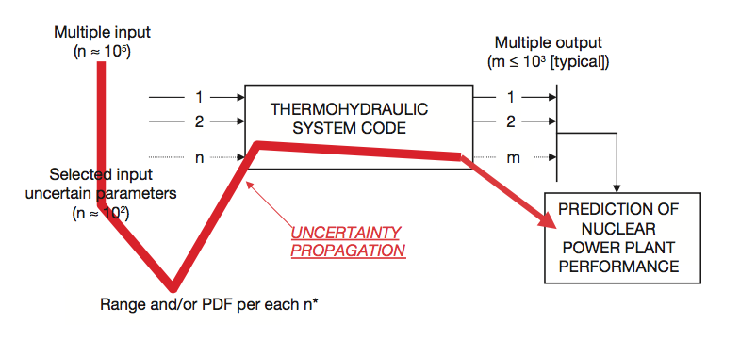
Scope & Problem Definition
Scope: Perform a simplified UQ analysis showing RAVEN capabilities
General problem: perform an UQ for a NPP perturbing TH system code input variables
Sample case: PWR, with a Station Blackout event
see 2016 IRUG presentation : C. Parisi, et al. “RELAP5-3D Analyses for the US-DOE LWRS/RISMC Program, Industry Application #2”

Slide 4
Problem Definition
UQ basic steps:
Selection of the NPP and scenario → PWR & SBO
Characterization of the scenario and identification of important phenomena → Simplified PIRT
Selection of the code → RELAP5-3D
Preparation and qualification of the input deck → see IRUG presentation
Selection of the uncertainty method → MC Perturbation
Application of the uncertainty method
Comparison of the results with the relevant criteria

Slide 5
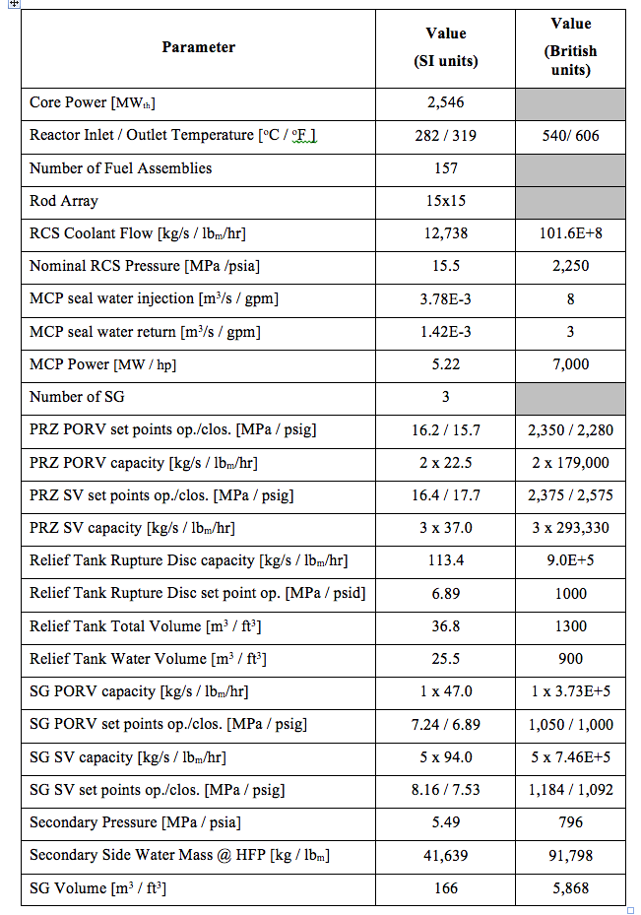
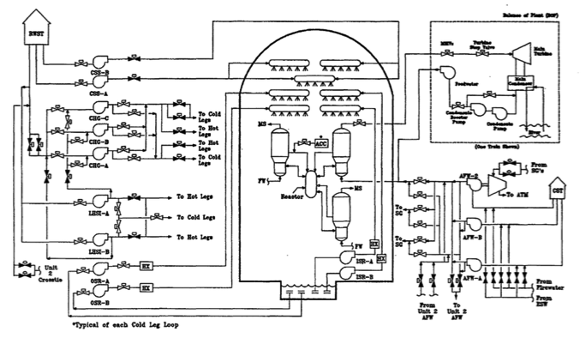
Problem Definition
INL-Generic PWR (IGPWR) defined for EE analysis
Main Characteristics:
3 Loop PWR / NSSS by Westinghouse
Core average power: 2546 MW_{th} [855 MW_{e}]
Core: 157 FA [15x15 Westinghouse FA]
Sub-atmospheric Containment
IGPWR ESF

Slide 6
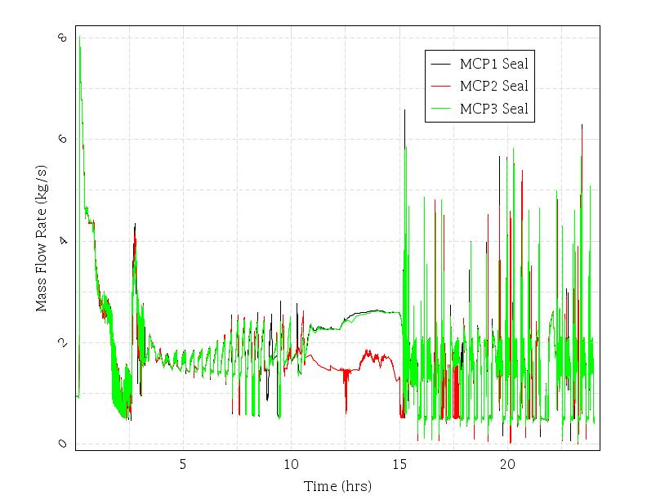
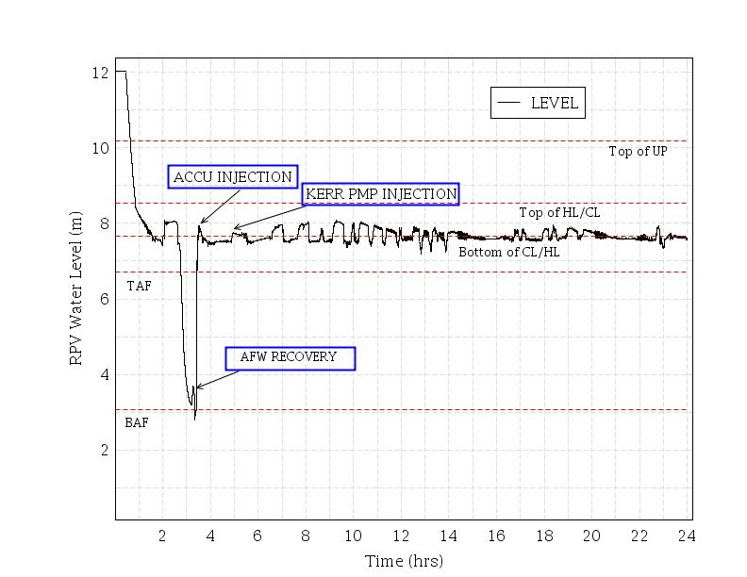
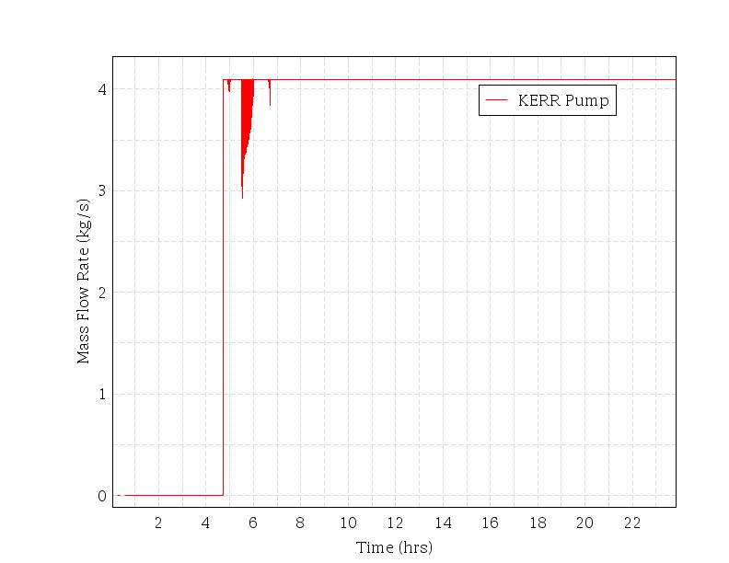
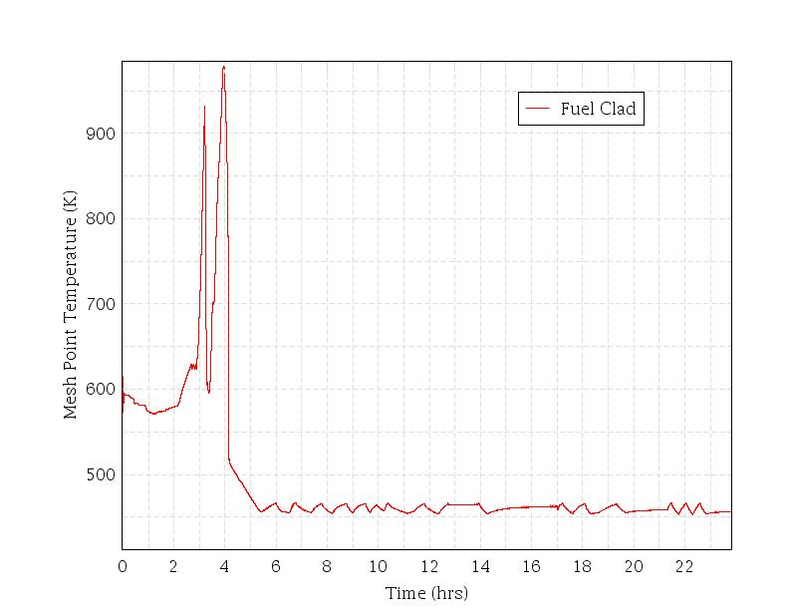
Problem Definition – Mitigated LTSBO with Battery Failures
EVENT DESCRIPTION | TIME [hh:mm] INL / RELAP5-3D
 | Early MCP seal failure (182 gpm)
Initiating event Station blackout – loss of all onsite and offsite AC power | 00:00
Reactor trip, MSIVs close MCP seals initially leak at 21 gpm/pump (~1 Kg/s) | 00:00
TD-AFW auto initiates at full flow | 00:01
RCP seal fail, leaking 182 gpm/pump | 00:13
First SG SRV opening | 00:15
Operators control TD-AFW to maintain level | 00:15
Batteries Faiilure, Stop of TD_AFW | 00:41
Recovery Actions, operators initiate controlled cooldown of secondary at ~100 F/hr (~55.5 K/hr) | 03:11
Accumulator Injection, RPV water level increase | 03:52
Kerr Pump Injjection | 04:43
Vessel water level begins to increase | N/A
Start emergency diesel pump injection into RCS | 03:30

Slide 7
RELAP5-3D/RAVEN Uncertainty Analysis
Simplified PIRT for Mitigated-LTSBO
Important TH phenomena influencing the PCT
NC in primary loop
Secondary Side Mass Inventory loss through SG SRV/ PORV
Primary Side Mass Inventory loss through MCP seal PRZ SRV/PORV
Heat Transfer between primary/secondary system
Selected RELAP5-3D input parameters to be perturbed by RAVEN code.
E.g., let`s perturb the followings,
Decay power
Valves flow areas
…and let’s apply Wilk`s formula (run 59 calculations)

Slide 8
RELAP5-3D/RAVEN Uncertainty Analysis
Let`s assume the following distributions
For Decay Power:
Uniform Distribution
Reference Value in Power Table: 1.62166 (MWth)
Variation: +/- 10%
For Valves Flow Areas:
Uniform Distribution
Reference Value: depending by the Valve type (SG/PRZ, PORV/SRV)
Variation: +/- 30%

Slide 9
RELAP5-3D/RAVEN Uncertainty Analysis
How to prepare a RELAP5-3D input deck being coupled to RAVEN code:
Use the RELAP5-3D multi-deck option
In a single Text File, past the Steady State and then the Transient File.
Both part should end with the input termination symbol (‘.’)
E.g.:
*this is a sample relap5 input deck for RAVEN – 1st part, or Steady State
100 new stdy-st
101 run
[..]
.
*2nd part here, or Transient
100 restart transnt
101 run
[..]
.

Slide 10
Workflow for UQ – SBO PWR
Run Info
Files & Model
Distributions
Sampler
Store in Database
Input File name: SBO_PWR.xml

Slide 11
UQ – SBO PWR – Explanations of Input Blocks
Run Info
Files
Models
Distribution
Functions
Samplers
Steps
Database
<RunInfo>
<WorkingDir>PWR_SBO</WorkingDir>
<RemoteRunCommand>raven_qsub_command.sh</RemoteRunCommand>
<Sequence>Ptest_DummyStep</Sequence>
<batchSize>59</batchSize>
<mode>
mpi
<runQSUB/>
</mode>
<NumMPI>1</NumMPI>
<clusterParameters>-P lwrs</clusterParameters>
<expectedTime>01:45:00</expectedTime>
</RunInfo>
Number of serial calculations
RELAP5-3D serial running
Falcon Cluster Parameters
Sequence to be run (see Steps)
Running Time

Slide 12
UQ – SBO PWR – Explanations of Input Blocks
Run Info
Files
Models
Distribution
Functions
Samplers
Steps
Database
<Files>
<Input name=”PWR_SBO.i" type="">PWR_SBO.i</Input>
<Input name="rellic.bin" type="">rellic.bin</Input>
<Input name="tpfh2o" type="">tpfh2o</Input>
<Input name="relap5.x" type="">relap5.x</Input>
</Files>
Files to be stored in the Working Directory
(../../PWR_SBO)

Slide 13
UQ – SBO PWR – Explanations of Input Blocks
Run Info
Files
Models
Distribution
Functions
Samplers
Steps
Database
Invoke the Relap5 Interface of RAVEN and call it “MyRELAP” .
Specify the RELAP5-3D executable name.
<Models>
<Code name="MyRELAP" subType="Relap5">
<executable>relap5.x</executable>
<alias variable="mult">2|0000599:6</alias>
</Code>
</Models>
This is a dummy variable. Needed when you have to perturb in the same way multiple R5 words
2nd RELAP5-3D input deck [transient},
Card 599, 6th word
0000599 time 0 gt null 0 1.0 n -1.0 * DUMMY TRIP FOR RAVEN CODE

Slide 14
UQ – SBO PWR – Explanations of Input Blocks
Run Info
Files
Models
Distribution
Functions
Samplers
Steps
Database
<Distributions>
<Uniform name="power_core">
<upperBound>1.783826</upperBound>
<lowerBound>1.459494</lowerBound>
</Uniform>
<Uniform name="multiplication">
<upperBound>1.3</upperBound>
<lowerBound>0.7</lowerBound>
</Uniform>
</Uniform>
Perturbation of the Decay Power
+/- 10%
Names of different Distributions
Perturbation of the Valve Flow Areas +/- 30%

Slide 15
UQ – SBO PWR – Explanations of Input Blocks
Run Info
Files
Models
Distribution
Functions
Samplers
Steps
Database
<Functions>
<External name='multiprzporv1' file='multiprzporv1.py'>
<variable>mult</variable>
</External>
<External name='multiprzsrv' file='multiprzsrv.py'>
<variable>mult</variable>
</External>
<External name='multisgporv1' file='multisgporv1.py'>
<variable>mult</variable>
</External>
<External name='multisgsrv' file='multisgsrv.py'>
<variable>mult</variable>
</External>
</Functions>
These files stores the reference values of the different valves.
They are being randomly perturbed +/- 30%
E.g., for multiprzporv1.py
[ PRZ PORV = 0.01811 ft² ]
def evaluate(self):
return 0.01811*self.mult

Slide 16
UQ – SBO PWR – Explanations of Input Blocks
Run Info
Files
Models
Distribution
Functions
Samplers
Steps
Database
<Samplers>
<MonteCarlo name="MC_samp">
<samplerInit>
<limit>59</limit>
</samplerInit>
<variable name="1|20210100:4">
<distribution>power_core</distribution>
</variable>
<variable name="mult">
<distribution>multiplication</distribution>
</variable>
Monte Carlo Sampler &
59 calculations,
Perturb in the 1st RELAP5-3D input deck the 4th word of card 20210100, using ‘power_core’ distribution
20210100 power 522 1.0 1.62166
Perturb the external variable ‘mult’, using ‘multiplication’ distribution

Slide 17
UQ – SBO PWR – Explanations of Input Blocks
Run Info
Files
Models
Distribution
Functions
Samplers
Steps
Database
<variable name="2|4440101:3, 2|4460101:3">
<function>multiprzporv1</function>
</variable>
<variable name="2|4450101:3">
<function>multiprzsrv</function>
</variable>
<variable name="2|2890101:3,2|3890101:3,2|4890101:3">
<function>multisgsrv</function>
</variable>
<variable name="2|2870101:3, 2|6870101:3,2|4870101:3,2|8870101:3,
2|870101:3, 2|7870101:3">
<function>multisgporv1</function>
</variable>
</MonteCarlo>
</Samplers>
Perturb in the 2nd RELAP5-3D input deck the 3rd word of card 4440101 & 4460101, using external function ‘multiprzporv1’
4440101 440000000 449000000 0.01811 0.0 0.0 00100
&
4460101 440000000 449000000 0.01811 0.0 0.0 00100

Slide 18
UQ – SBO PWR – Explanations of Input Blocks
Run Info
Files
Models
Distribution
Functions
Samplers
Steps
Database
<Steps>
<MultiRun name="Ptest_DummyStep" verbosity="debug" re-seeding="1">
<Input class="Files" type="">SURRY2_A6d2_MD.i</Input>
<Input class="Files" type="">tpfh2o</Input>
<Input class="Files" type="">rellic.bin</Input>
<Input class="Files" type="">relap5.x</Input>
<Model class="Models" type="Code">MyRELAP</Model>
<Sampler class="Samplers" type="MonteCarlo">MC_samp</Sampler>
<Output class="Databases" type="HDF5">DataB_REL5_1</Output>
</MultiRun>
</Steps>
Execute in Multi-Run mode the Sequence “Ptest_DummyStep”:
Load RELAP5-3D Files
Load RELAP5-3D Interface called ‘MyRELAP’ {see Models}
Execute Sampler “MC_Samp”
Store Sampled Variables in a HDF5 Database

Slide 19
UQ – SBO PWR – Explanations of Input Blocks
Run Info
Files
Models
Distribution
Functions
Samplers
Steps
Database
<Databases>
<HDF5 name="DataB_REL5_1" readMode="overwrite"/>
</Databases>
Store all the Sampled Variable in this Database.
!Overwrite mode → Old Database are being rewritten!

Slide 20
UQ – SBO PWR
Running the code:
Python ~/../raven/framework/Driver.py PWR_SBO.xlm
The run is queued on the server. 59 parallel calculations are being runned.
Remark: external function files (e.g., multiprzporv1.py) should be written in the working directory

Slide 21
Workflow for UQ – Post-Processing
Run Info
Files & Model
Database
DataObjects
Steps
OutStreams
Input File name: Out_Processor.xml

Slide 22
UQ – SBO PWR – Explanations of Input Blocks Post processing
Run Info
Files
Models
Steps
Database
DataObjects
OutStreams
<RunInfo>
<WorkingDir>.</WorkingDir>
<Sequence>LOAD, SYNCRONIZE, STATICS, READ, PRTFILE</Sequence>
<batchSize>1</batchSize>
</RunInfo>
Serial Calculation for Post-processor
Sequence to be run (see Steps):
LOAD database
SYNCRONIZE time histories
Perform Basic Statistics (STATICS)
Read the output of the Basic Statistics (READ)
Print the output (PRTFILE)

Slide 23
UQ – SBO PWR – Explanations of Input Blocks Post processing
Run Info
Files
Models
Steps
Database
DataObjects
OutStreams
<Files>
<Input name="OutStatistix" type="xml">OutStatistix.xml</Input>
</Files>
File created by RAVEN in the Working Directory (./). It stores the data being processed

Slide 24
UQ – SBO PWR – Explanations of Input Blocks Post processing
Run Info
Files
Models
Steps
Database
DataObjects
OutStreams
<Models>
<PostProcessor name='alpha’ subType='BasicStatistics’>
<what>expectedValue,percentile, pearson</what>
<parameters>httemp_1111010_12,cntrlvar_115</parameters>
<pivotParameter>time</pivotParameter>
</PostProcessor>
<PostProcessor name='beta' subType='RavenOutput'>
<File name='OutStatistix' >
<output name='expv'>httemp_1111010_12|expectedValue</output>
<output name='95up'>httemp_1111010_12|percentile_95</output>
<output name='5down'>httemp_1111010_12|percentile_5</output>
<output name='pearson1'>cntrlvar_115|pearson|httemp_1111010_12</output>
</File>
<dynamic>t</dynamic>
</PostProcessor>
[..]
Perform BasicStatistics on the Database. Extract expected value, percentile and pearson coefficient for the listed variables as funtion of time
Create a RavenOutput database where to store the basic statistics of the listed variables.

Slide 25
UQ – SBO PWR – Explanations of Input Blocks Post processing
Run Info
Files
Models
Steps
Database
DataObjects
OutStreams
[..]
<PostProcessor name="syncronizeHistorySet” SubType="InterfacedPostProcessor">
<method>HistorySetSync</method>
<syncMethod>grid</syncMethod>
<numberOfSamples>21600</numberOfSamples>
<timeID>time</timeID>
<extension>extended</extension>
</PostProcessor>
</Models>
Syncronize the 59 different Time Histories. Use a grid with 21600 points (!PWR SBO lasted >8 hrs!)

Slide 26
UQ – SBO PWR – Explanations of Input Blocks Post processing
Run Info
Files
Models
Steps
Database
DataObjects
OutStreams
<Steps>
<IOStep name="LOAD">
<Input class="Databases" type="HDF5">DataB_REL5_1</Input>
<Output class="DataObjects" type="HistorySet">DATA_OUT</Output>
</IOStep>
<PostProcess name="SYNCRONIZE">
<Input class="DataObjects" type="HistorySet">DATA_OUT</Input>
<Model class="Models" type="PostProcessor">syncronizeHistorySet</Model>
<Output class="DataObjects” type="HistorySet">HistorySetPPTSyncronized</Output>
</PostProcess>
<PostProcess name="STATICS">
<Input class="DataObjects” type="HistorySet">HistorySetPPTSyncronized</Input>
<Model class='Models' type="PostProcessor">alpha</Model>
<Output class="Files" type=" ">OutStatistix</Output>
</PostProcess>
[..]
Steps:
LOAD the HDF5 database and store its content in a DataObjects “DATA_OUT” for HistorySet
SYNCRONIZE the HistorySet in the “DATA_OUT” DataObjects and write in a new DataObjects called “HistorySetPPTSyncronized”
Take the syncronized DataObjects, perform basic statsitcs and write results on Outstatstix.xml file

Slide 27
UQ – SBO PWR – Explanations of Input Blocks Post processing
Run Info
Files
Models
Steps
Database
DataObjects
OutStreams
[..]
<PostProcess name="READ">
<Input class="Files" type=" ">OutStatistix</Input>
<Model class='Models' type="PostProcessor">beta</Model>
<Output class="DataObjects"type="PointSet">PRINT</Output>
</PostProcess>
<IOStep name="PRTFILE">
<Input class="DataObjects" type="PointSet">PRINT</Input>
<Output class="OutStreams" type="Print">chart</Output>
</IOStep>
</Steps>
Steps:
Read from the OutStatistix.xml file the basic statistics, extract the selected variables declared in ‘beta’ and write in a DataObjects PointSet called PRINT
From PRINT DataObjects, extract and print the info requested in an OutStreams object (→ chart.csv file)

Slide 28
UQ – SBO PWR – Explanations of Input Blocks Post processing
Run Info
Files
Models
Steps
Database
DataObjects
OutStreams
<DataObjects>
<HistorySet name="DATA_OUT">
<Input>1|20210100:4</Input>
<Output>time, httemp_1111010_12, cntrlvar_115</Output>
</HistorySet>
<HistorySet name="HistorySetPPTSyncronized">
<Input>1|20210100:4</Input>
<Output>time, httemp_1111010_12, cntrlvar_115</Output>
</HistorySet>
<PointSet name="PRINT">
<Input>time</Input>
<Output>expv, 95up, 5down, pearson1</Output>
</PointSet>
</DataObjects>
Dummy Variable needed by RAVEN
Define All DataObjects to be used in the Sequence and the variables that they contain.

Slide 29
UQ – SBO PWR – Explanations of Input Blocks Post processing
Run Info
Files
Models
Steps
Database
DataObjects
OutStreams
<OutStreams>
<Print name='chart'>
<source>PRINT</source>
<type>csv</type>
</Print>
</OutStreams>
OutStreams: print the content of the DataObjects PRINT in the chart.csv file

Slide 30
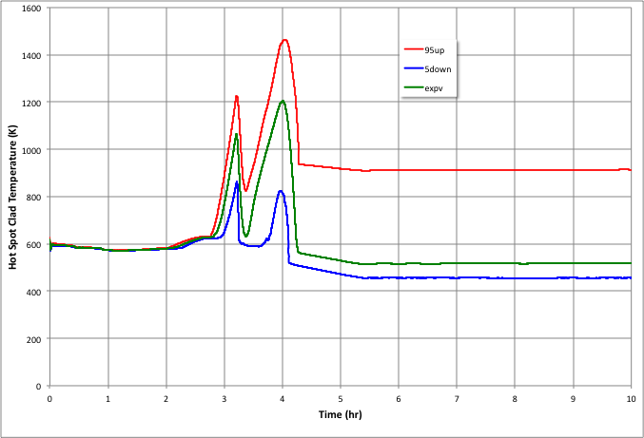
Final Results
Pearson Correlation Coefficient for PCT
Decay Power: +0.0796
Expected Value, 95 and 5 Percentile of the PCT

Slide 31
Tricks & Pitfalls
RAVEN can not access RELAP5-3D plotf/restart files
Variable to be sampled/processed should be stated as Minor Edits in the RELAP5-3D Input Deck
Direct access to plotf/rstr to be implemented in the future
Since the Post Processor is running in serial mode, be prudent in not using a large number of points for the grid

Slide 32
Thank you Questions?

